Slide 1
Optimising access for the last mile: Geospatial cost model for point of care viral load instrument placement
Sarah J Girdwood^{b}, Brooke E Nichols^{a,b}, Crispin Moyo^{d}, Thomas Crompton^{c}, Dorman Chimhamhiwa^{c}, Sydney Rosen^{a,b}, for EQUIP Health ª Department of Global Health, School of Public Health, Boston University, Boston, MA, 02118, USA. ^{b} Health Economics and Epidemiology Research Office, Department of Internal Medicine, School of Clinical Medicine, Faculty of Health Sciences, University of the Witwatersrand, Johannesburg, South Africa. ^{c} Right to Care, GIS Mapping Department, Johannesburg, South Africa. ^{d} EQUIP Zambia, Lusaka, Zambia
Geomapping to Enhance Equitable Access
The speaker has no conflicts of interest to disclose

Slide 2
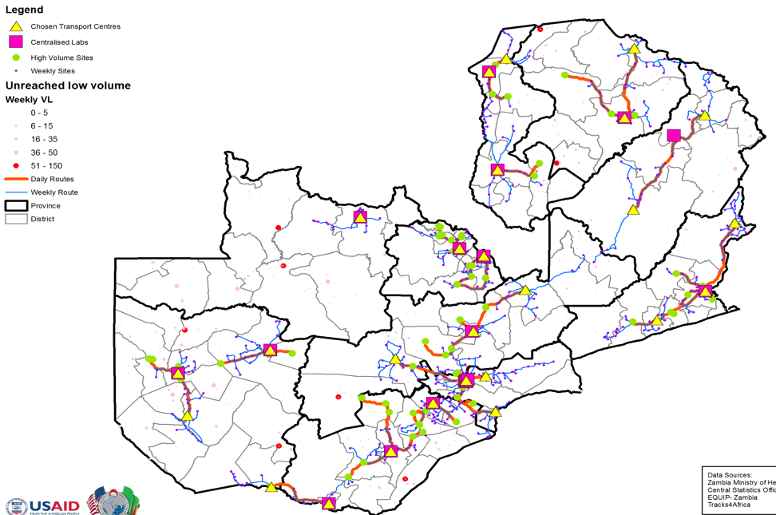
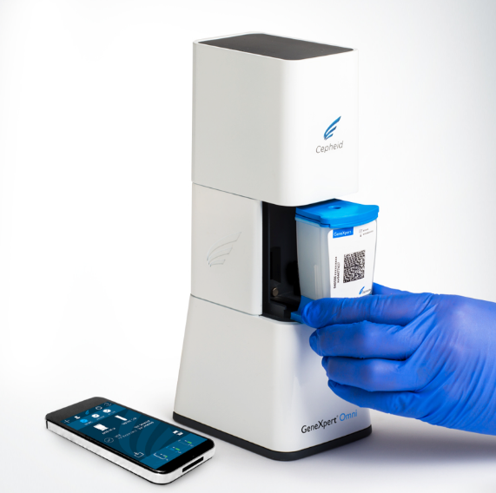
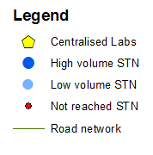
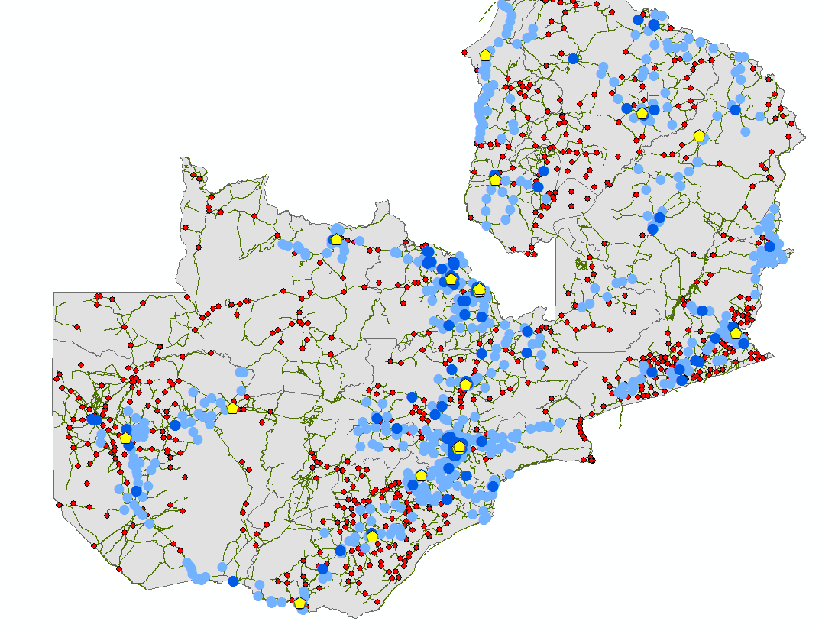
BACKGROUND
Rapid scale up of viral load monitoring programs
But little attention has been paid to:
how to optimize viral load access to the ‘last mile’ facilities
the role of new point of care (POC) testing technologies
A previous analysis used data from the Zambian viral load program to develop a national sample transportation network (STN)
It optimized a centralised lab network for 90% of estimated viral load volumes.
Efficient but not equitable (54% of facilities)

Slide 3
METHODOLOGY
For the hardest-to-reach facilities in Zambia not reached by the modelled national STN, we compared the cost of placing POC viral load test instruments at or near facilities to the cost of an expanded STN to deliver samples to centralized laboratories.
Developed a geospatial model to:
Identify candidate (remote & low-volume) POC facilities not reached by the national STN
1
2
Optimally locate POC instruments maximizing both viral load coverage and instrument utilisation
The geospatial model output is included in a cost model to determine the total cost (test and transport) with 3 scenarios:
1
POC placement at all facilities identified as POC candidates
Optimised combination of true on-site POC and near-POC placement at facilities acting as POC hubs
2
3
Integration into the centralised STN to allow use of centralised labs

Slide 4
RESULTS
675/1475 (46% of ART facilities) are not reached by the modelled national STN.
337/675 (23% of ART facilities) were identified as POC candidates (remote & low volume).
These 337 facilities represent 3.2% of total viral load volumes
An optimised combination of true and near-POC (scenario 2) outperforms the other scenarios.
Cost per test in scenario 2 is 19% lower than scenario 1 due to better instrument utilisation (26% v. 10%)
Cost per test in scenario 2 is 53% lower than scenario 3 due to lower transport costs ($7 v $31)
Using a novel geospatial modelling approach, POC viral load testing may reduce the costs of providing testing services to the hardest-to-reach populations, despite the cost of equipment and low patient volumes.
Notes:
Add map animation

Slide 5
Disclaimer
This presentation is made possible by the support of the American people through the United States Agency for International Development (USAID). The contents are the sole responsibility of Right to Care and do not necessarily reflect the views of USAID or the United States Government.

Slide 6
Thank you

